Slide 1


Smart Body Area IoT (BAIoT) in 6G
Presented by J. Farserotu and Philippe Dallemage
6G Wireless Summit
TS22: Special Session: eHealth
Notes:
My presentation today is on Smart Body Area IoT in 6G. I would like to thank the organizers of the 6G Wireless Summit, Special session on Health, for inviting me to make this preparation and apologize for the fact that I cannot be here in person today.

Slide 2
Outline
Introduction
State-of-the-Art
ETSI TC SmartBAN
SmartBAIoT in 6G
Concluding remarks
Notes:
Following an introduction, we present an overview of the State-of-the-Art in wireless BAN.
The status of developments and current plans in the European Telecommunications Institute (ETSI) Technical Committe (TC) on Smart Body Area Networks (SmartBAN) are discussed.
The potential evolution of smart body area networks in the future IoT and 6G from higher frequencies to AI / ML enabled security, privacy and trust are examined and the challenges are discussed.

Slide 3
Introduction
  Status and future of WBAN = smart body area networks (SmartBAN) and the IoT in 6G
    The IoT is rapidly growing in numbers and requirements. 5G is emerging and barely covers the needs.
    IoT becomes smarter, with the edge sharing information with the cloud across all layers (fog, mist, etc.)
    BAN is no different! Personal devices, even highly miniature sensor devices, are being endowed with powerful edge processing and computing capabilities.
    Call it SmartBAIoT
  The question is:
    6G is on the horizon. Should 6G address all these requirements?
    The answer is of course “yes”
    Followed by “ok, what, how and when?”
Notes:
Today, the IoT is rapidly growing. 5G is already emerging and barely meets the needs.
At the same time, the IoT is becoming smarter, with the edge sharing informationwith the cloud across all layers.
BAN is no different! We may view our personal IoT devices, and in particular our body sensor devices, as highly miniature sensor devices that are being increasingly endowed with highly capable, edge processing and computing capabilities.
We take a holistic view in which our SmartBAN = a system with wearables, nearables and “virtuals”
Wearables = worn or carried devices
Nearables = near devices (within personal space)
Virtuals = remotely connected devices
We refer to this herein as SmartBAIoT
As we will see, it is controlled by smart coordinator.
An example of the role of the smartcoordinator will be provided for the case of digital health later in this presentation.

Slide 4
Overview of current WBAN characteristics (2.4 GHz band)
Parameter |  | BTLE | IEEE 802.15.6™ | SmartBAN
System | System Architecture | One hub | One hub | Hub + smart relay coordination
 | Networking communication interoperability (SmartBAN and non-SmartBAN nodes) | No | No | Yes
 | Smart relay | No | No | Yes
PHY/MAC | FEC (forward error correction) | Yes (BT 5) | Yes | Yes
 | Initial set up time | Less fast | Less fast | Fast
 | Spread spectrum hopping | Yes | Yes (in limited cases) | No
 | Channel reassignment | No | Multiple channel | Yes
 | Very low latency emerging messaging | No | Medium (super-frame) | Very fast (timeslot)
 | Reutilization of scheduled unused time slots (efficiency parameter) | No | No | Yes
 | Energy consumption/efficiency | Low | Medium | Low (e.g. long sleep times)
 | Network complexity | Star concept | Star concept + relay | Star + multi hub relay (planned)
Smarts | Semantic approach, semantic interoperability, heterogeneity management, IoT compliance | No | No | Yes
 | Additional semantic and data analytic enablers (e.g. semantic discovery, reasoning/rules) | No | No | Yes
 | Automatic node discovery (e.g. semantic discovery of nodes, composition) | Partially | No | Yes
 | Coexistence management by coordinator | Low | Low | High
SmartBAN aims at a smart BAN design with improved and dedicated performance for medical, health improvement and sport and leisure applications, further to existing BAN standards
Notes:
Various wireless connectivity solutions have been and continue to be used in BAN today, including 433MHz, 868 MHz, 2.4GHz radio. Today though, it is typified by the industry standard 2.4GHt Bluetooth Low Energy connecitvity.
Additionally, the IEEE defined a standard specifically for wireless BAN i.e., IEEE 82.15.6
In this table, we provide an overview of BTLE, IEEE802.15.6 and SmartBAN.
On the system side, we can see that SmartBAN differs in that it supports relay.
At the PHY-MAC level, SmartBAN is designed to provide for rapid setup time and low latency
In terms of «smarts», SmartBAN offers a semantic approach that enhances heterogeneity management, provides for semantic and data enablers such as semantic discovery and offers automatic node discovery. Important features for operation in fuitre smart IoT environments.
In summary, SmartBAN aims at a design with improved and dedicated performance for health, medical, sport and leisure activities.

Slide 5
ETSI TC SmartBAN status – TR and TS
TC SmartBAN has released the following specifications and reports:
Status | Number | Title | Date
Published | TS 103 326 Ver. 1.1.1 | Smart Body Area Network (SmartBAN), Enhanced Ultra-Low Power Physical Layer | 2015-04-28
 | TS 103 325 Ver. 1.1.1 | Smart Body Area Network (SmartBAN), Low Complexity Medium Access Control (MAC) for SmartBAN | 2015-04-28
 | TS 103 378 Ver. 1.1.1 | Smart Body Area Networks (SmartBAN), Unified data representation formats, semantic and open data mode | 2015-12-11
 | TR103 395 Ver. 1.1.1 | Smart Body Area Network (SmartBAN); Measurements and modelling of SmartBAN Radio Frequency (RF) environment | 2016-12-20
 | TR103 394 Ver.1.1.1 | Smart Body Area Networks (SmartBAN); System Description | 2018-1-15
 | TS 103 327 Ver. 1.1.1 | Smart Body Area Networks (SmartBAN); Service and application standardized enablers and interafces, APIs and infrastructure for interoperability management | 2019-04
Our focus has been this far on 2.4GHz…
Notes:
ETSI TC SmartBAN has produced 4 technical Specifications (TS) and 2 Technical Reports (TR).
The 4 Technical Specifiactions cover the PHY and MAC, the unified data representation formats and the service and application standardized enablers and interfaces.
The Technical reports cover measurements and modelling and the overall system description

Slide 6
ETSI TC SmartBAN – Work Items
There are currently 10 Work Items (WI) in progress:
ETSI Number | WKI Reference | Title Part 1 | Title Part 2
103 671 | DTR/SmartBAN-001 | Smart Body Area Networks (SmartBAN) | Comparative analysis between SmartBAN and other short-range standards
--- | DTR/SmartBAN-003 | Smart Body Area Networks (SmartBAN) | Implant communications
103 638 | DTR/SmartBAN-0010 | Smart Body Area Networks (SmartBAN) | Security, privacy and trust; state of the art, use cases treats and requirements analysis
103 711 | DTR/SmartBAN-0014 | Smart Body Area Networks (SmartBAN) | Applying SmartBAN MAC (TS 103 325) for various use cases
103 325 | RTS/SmartBAN-005r1 | Smart Body Area Network (SmartBAN) | Low Complexity Medium Access Control (MAC) for SmartBAN
103 678 | DTS/SmartBAN-002 | Smart Body Area Networks (SmartBAN) | System level description and requirements
103 326 | RTS/SmartBAN-0017 | Smart Body Area Network (SmartBan) | Enhanced Ultra-Low Power Physical Layer
103 378 | RTS/SmartBAN-009r1 | Smart Body Area Networks (SmartBAN) | Unified data representation formats, semantic open data model and corresponding ontology
--- | PWI_SmartBAN_1905_v1 | Smart Body Area Networks (SmartBAN) | SmartBAN Coordinator requirements, main functionalities and specifications
103 710 | PWI_SmartBAN_1903_v2 | Smart Body Area Networks (SmartBAN) | SmartBAN Data Scanner Agent specification, implementation and validation
Trending now towards the “smart coordinator” and other frequency bands
Notes:
In addition to the Technical Specifcations and Reports that have been produced, today there are also 10 work items in progerss covering a range of topics from enhancements to TS / TR to IR-UWB for an endoscopic application, security and the data scanner agent.
Our focus is shifting towards the «SmartCoordinator» and frequency bands beyond 2.4GHz for WBAN.

Slide 7
2.4 GHz PHY-MAC technical requirements
1. Ultra Low Power Design
  HUB/Node Role Sharing
    HUB takes care of MAC operation functionality as much as possible. Node operation is designed to be minimum.
    Low complexity/low energy is maintained by exploiting the two-channel approach
2. Timely Accessible Mechanism
  Emergency Signal Transmission
3. Co-existence / Robustness
  Co-existence between HUBs
  Automatic interference avoidance between BANs using the same D-ch
4. QoS Optimization Mechanism
  Transmission (re-transmission) at the required BER, latency, etc.
Source: H. Takana
Notes:
SmartBAN has defined four basic technical requirements with respect to the PHY-MAC:
Ultr Low Power design
Timeliness
Co-existence / robustness
QoS optimization
The four technical requirements are resolved by the two channel concept. The meaning of the frame structure is twofold:
- First, the D-ch frame can transmit data together with its QoS parameter.
- Second, the emergency signal can transmit at any time both in the SAP and CMP portion of the D-ch
SmartBAN offers automatic interference avoidance between BANs using the same channel. If a BAN whose D-ch frequency is the same channel is coming closer, either of them can transmit the D-ch number. The decision as to which should transition is left as an implementation matter.
SmartBAN also provides QoS optimization mechanisms. QoS optimization can be accomplished by setting the QoS parameter in each D-ch frame. There are four QoS levels and QoS is managed by the hub (SmartCoordinator)

Slide 8
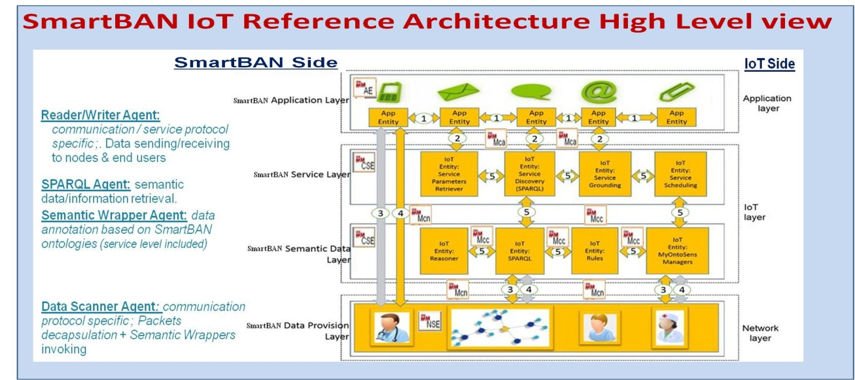
Data representation and interoperability management
A BAN (SmartBAN) – data, device, service/application – unified semantic and open reference model with modular ontology:
  key element for BANs data / device interoperability,
  XaaS/WoT strategy for semantic interoperability handling, device discovery and composition facilities, data sharing at app level and cross domain use case handling
  eases automated monitoring / control implementation
A BAN (SmartBAN) with more integrated IoT reference architecture for secure interaction / access:
  specified on top of the SmartBAN reference model,
  oneM2M and Multi-Agent based, addresses network / syntactic / semantic interoperability,
  generic service enablers for semantic data sharing / management, embedded semantic analytics (device/edge/fog level), distributed monitoring / control
Source: M. Girod-Genet
Notes:
This figures provides a High level view of SmartBAN IoT Reference Architecture
The SmartBAN IoT reference architecture provides for a unified semantic and open reference model with modular ontology, It supports data / device interoperability and uses an Xaas/WoT strategy for semantic interoperability

Slide 9
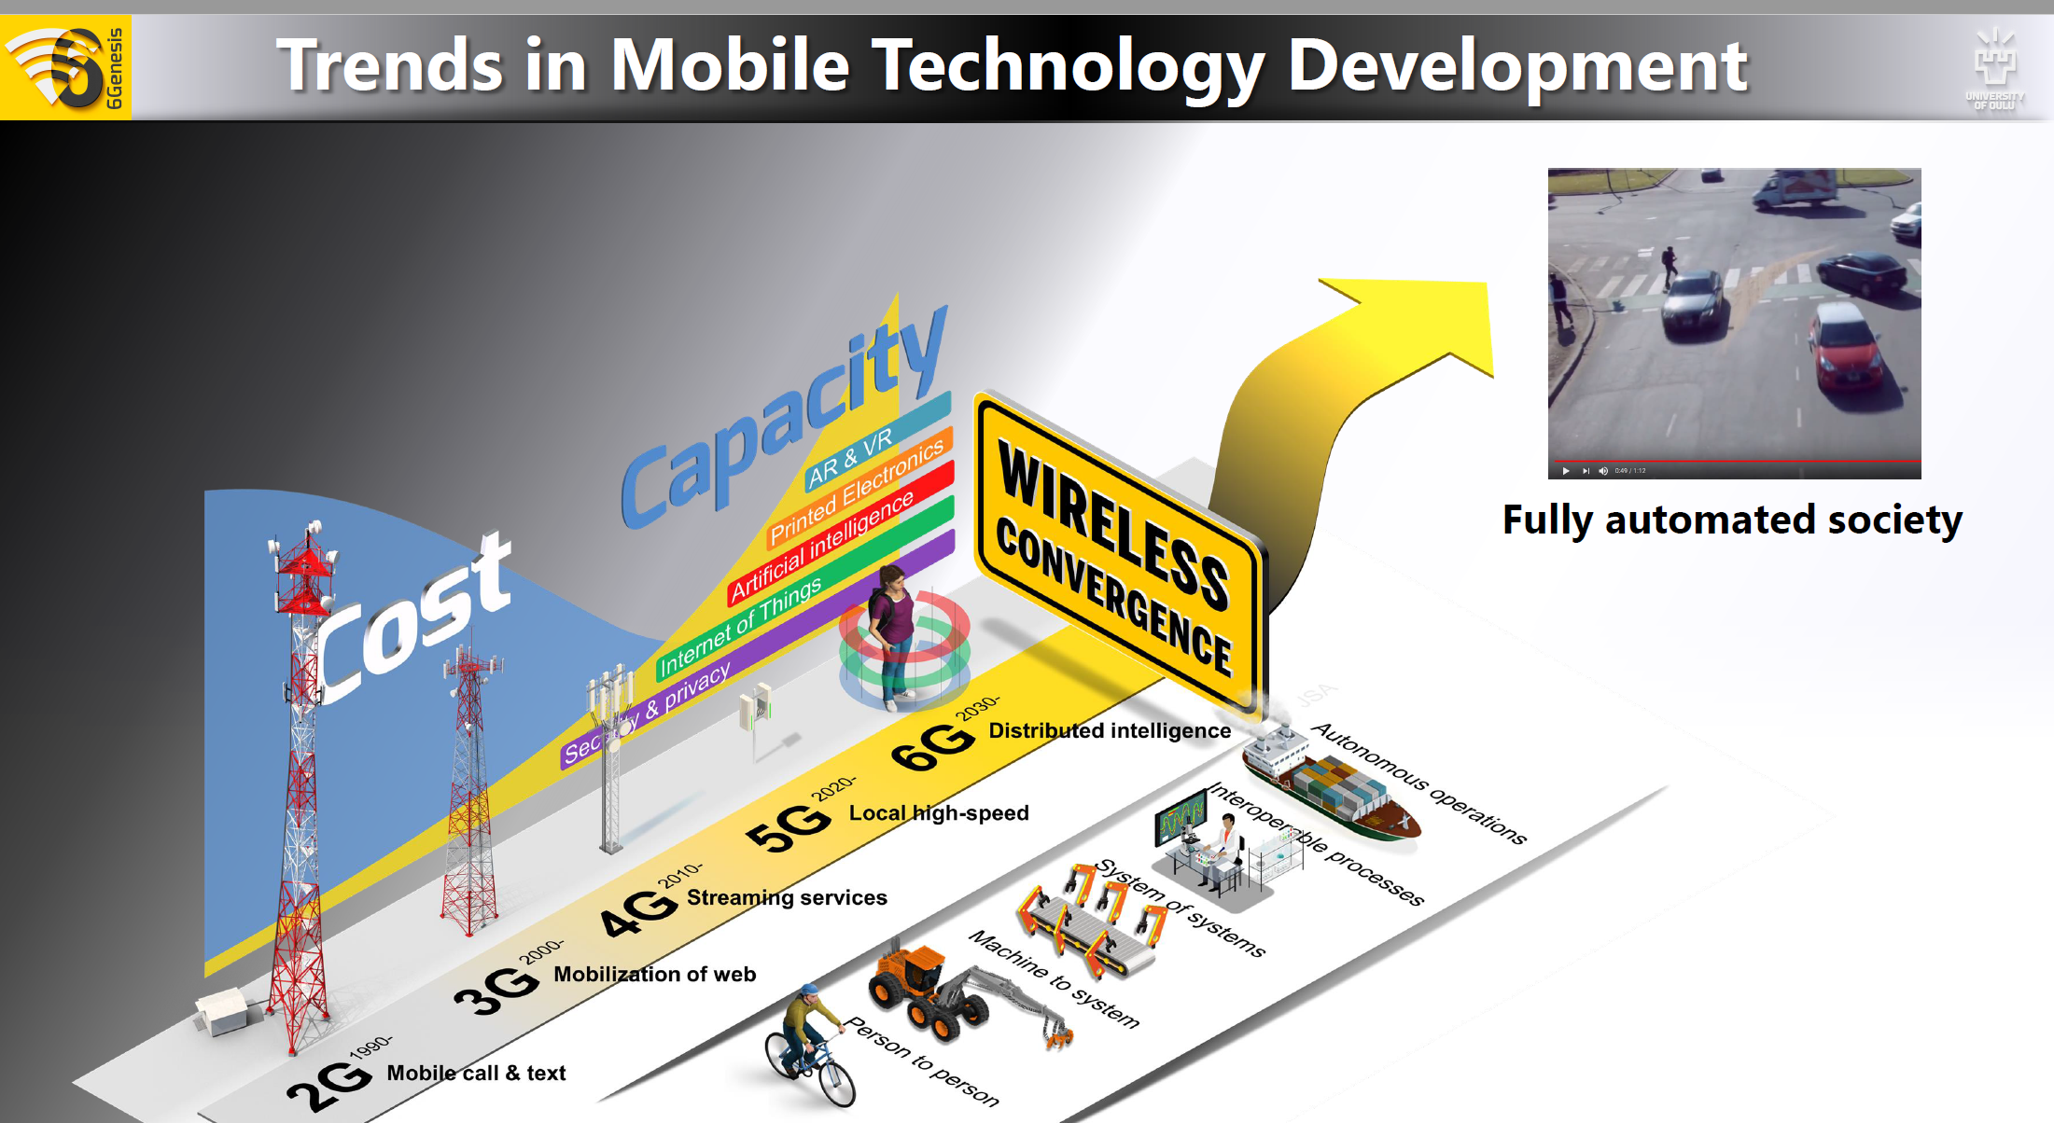
What is 6G?
“When wireless is perfectly applied the whole earth will be converted into a huge brain…We shall be able to communicate with one another instantly, irrespective of distance. Not only this, but…we shall see and hear one another as perfectly as though we were face to face, despite intervening distances of thousands of miles; and the instruments through which we shall be able to do this will be amazingly simple present telephone. A man will be able to carry one in his vest pocket.” - N. Tesla
6G, distibuted intelligence in action, the future of wireless and of BAIoT
Much has been accomplished, yet much remains before wireless is “perfectly applied” and distributed intelligence realized
Notes:
Now we turn our attention to the subject of SmartBAN in 6G, but before doing so, we would like to consider the question of «What is 6G?»
From Nicolas Tesla, we have the quote that you see which we feel remains very relevant today: «When wireless is perfectly applied the whole earth will be converted into a huge brain…» - distrubuted intelligence!
And in our view 6G will be distributed intelligence in action, the future of wireless and of BAIoT.
In short, much has been accomplished in wireless, yet much still remains to be done before wireless is perfected and the vision of Tesla of a distributed intelligence can be realized.
We believe that this can be in the timeframe of 6G

Slide 10
A perspective on 6G and BAN
Mobile
(e.g. GSM, GPRS, 3G, 4G, 5G)
6G - IoT
Connectivity for IoT devices
Any rate, low latency
Multi-standard, multi-functional
Distributed intelligence
Smart edge (AI / ML)
Secure and private with
Embedded trust
WBAN, WPAN, WSN
(e.g. sensors)
WiFi
(e.g. laptops, pads)
Enabled by smart edge devices and distributed intelligence across layers and systems
Notes:
So we may ask ourselevs, what is the relationship between 6G and BAN?
In the past, mobile, WBAN / WPAN / WSN and WiFi were separate systems. Going forward, we can imagine them merged into one system: 6G – IoT. This system provides for seamless, multi-standard connectivity of IoT devices. It provides for secure and private E2E connectivity with embedded trust. Service is flexible and our devices, including our BAN devices, represent the «smart edge» and may be capable of cooperating.

Slide 11
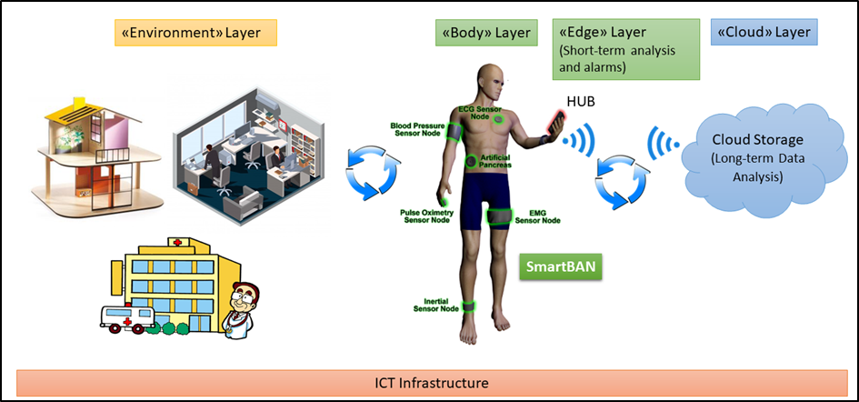
SmartBAN in 6G – IoT: a view to the future
Source: L. Mucchi
6G IoT infrastructure
Notes:
Here we illustrate a vision of SmartBAN in the 6G –IoT. Connectivity and interaction occur across multiple layers: the environment, the body and the edge / coordinator and the cloud). All connected via 6G – IoT infrastructure

Slide 12
What is needed?
6G [1]
  6G needs a network with embedded trust… – privacy protection will be a key enabler.
  Artificial intelligence (AI) and block chains may play a major role in 6G networks.
  6G is not only about moving data: it will become a framework of services, including communication services (and more).
  In 6G, all user-specific computation and intelligence may move to the edge cloud.
SmartBAN / Smart BAIoT
  Wearables and nearables represent an especially fast growing segment of the IoT
  SmartBAN needs a “Smart Coordinator”, which may be viewed as a smart edge device that is capable of controling / coordinating the operation of our BAN in an efficient and transparent manner.
  Key functionalities include e.g. : 1) coordination / interface / interoperability (wireless, system), 2) security, privacy & trust, 3) interaction / cooperation and 4) edge processing / AI
[1] FOR 6G UBIQUITOUS WIRELESS INTELLIGENCE. 6G Research Visions 1, September 2019, 6G Flagship, University of Oulu
Notes:
In order to realize our vision of SmartBAN in the 6G – IoT, there are a number of requirements:
6G requires a network with embedded trust and privacy protection
A strong reliance on AI / ML and blockchains is expected
Movement of intelligence to the edge. SmartBAN requires a smart coordinator. This may be viewed as an edge initially. Ultimately, it can move to sensor devices as well
Wherever implmenetd, the smart coordinator must support functionalities that include: 1) coordination, interfacing and interoperability for connectivity, 2) security, privacy and trust, 3) interaction and coorperation in smart environments and 4) edge processing and AI / ML

Slide 13
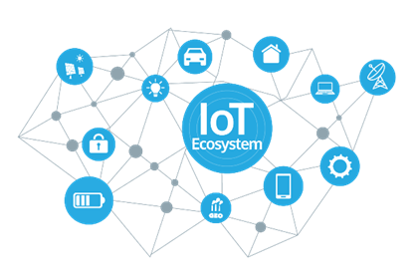
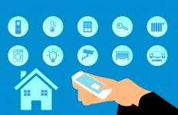

The system: SmartBAN / BAIoT for Digital Health
Personal cloud
Personal environment
Smart edge devices
Personal health data
6G - IoT cloud
Healthcare centers
Healthcare professionals
Big Data analysis (AI)
Reference health data
Interaction
Sensing
Location
Anonymized data
Personalized medecine
Preventative treatment
Wearables = worn or carried devices
Nearables = near devices (within personal cloud)
Virtuals = remotely connected devices
The SmartBAN edge - your personal interface to the digital healthcare system of the future!
Sources:
Future Health: https://ec.europa.eu/futurium/en/system/files/ged/futurehealth_white_paper.pdf, Health EU, https://www.health-eu.eu/
Digi Twins: http://www.engineersjournal.ie/2018/06/12/revolutionary-healthcare-proposal-digitwins-seeking-eu-flagship-success/
This Photo by Unknown Author is licensed under CC BY-SA
Notes:
Here we see an example of SmartBAN / BAIoT applied to the case of Digital Health.
On the left hand side, we have our personal cloud consisting of our personal devices, (e.g. sensors), and smart edge devices, such as the SmartBAN coordinator. Our devices include weables, nearables and virtuals and our devices may interact with other devices within our personal environment.
On the right hand side we have the 6G – IoT cloud, consisting of e.g. healthcare centers, healthcare professionals and big data analylitics
In a sense, the SmartCoordinator may be viwed as a personal guardian or avatar. We envision the coordinator in this sense as our personal interface to the healthcare system of the future. Our avatar is effectively an Artificial Intelligence (AI). We rely on our trusted smartcoordinator to perform anything from low level radio adaptation to high level functionalities related to filtering and processing of information and security.
Our smartcoordinator (and other capable edge devices) may processes this data locally and provide us with tailored feedback. The feedback is based on knowledge of our personal case and the collective wisdom established via AI based analysis of big data gathered over years from all of the persons in the system. It may also perform predictive simulations and projections in reply to what if questions that we may pose, or which it poses on our behalf, and it supports personalized medicine (e.g. monitoring of dosage and drug combinations). It receives reference data from the system and returns anonymized data to the system, enabling it to continuously refine and update the global database.
Our smartcoordinator is also capable of interacting with sensors in the environment and cooperating with other AI based devices. It can also serve as a “fail safe” storing recent personal history and confirming that incoming data and requests are consistent with expectations, which is potentially important in the event of system corruption (e.g. spoofing, falsification of reference data).
The realization of our smartcoordinator of the future requires an unprecedented combination of intelligence embedded in a miniaturized, energy efficient processing platform with trusted and dependable connectivity to the cloud 24/7.
In this way, SmartBAN is “our edge” and personal interface to the digital healthcare system of the future.

Slide 14
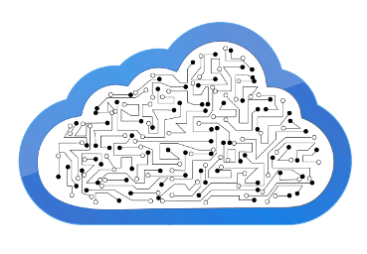

Open E2E security and privacy platform (e.g. Digital Health)
Inner personal health domain
Outer digital health domain
IoT cloud
Secure infrastructure
Personal cloud
SmartCoordinator
Data sources:
Wearable sensors
Nearable sensors
Remote devices
Implantable sensors
Lab-on-Chip
Anonymization
Authentication
Identity mangement
Secure access control
Local analytics
Fail safe & alarms
Trusted agent
And more…
Storage of health records
Big data analysis
Anonymized reference data
Personal health data,
location, context
Feedback (e.g. treatment)
E2E security, privacy and trust
The SmartCoordinator - your trusted personal guardian in a complex Digital Society!
Notes:
To be our trusted interface to the digital world, our the SmartCoordinator must maintain the security and privacy of our information. To do so, we envision the realization and embedding of an open and modular end-to-end (E2E) security, privacy and trust platform within the smartcoordinator (e.g. mobile, watch or wristband).
The platform would provide efficient, robust and secure communication in the local domain, useful functionality in the outer domain, helping the patient maintain high confidence in the security and privacy of their data and the application
The functionalities of the E2E security platform are illustrated within the intersection of our personal cloud and the IoT cloud secure infrastructure. They include e.g. ananymization, authentication, identity management, secure access control, local analytics, fail safe & alarms and more
In this way, our SmartCoordinator can be our trusted personal guardian and interface in an increasingly complex digital society.

Slide 15
So then, what is BAIoT in 6G
Smart BAIoT edge devices, AI to the edge – your edge
Wearables, nearables, virtuals – your private IoT
Connectivity, sensing, interaction – multi-functional
Distributed intelligence (e.g. distributed ID) – cooperative, autonomous
E2E security, privacy and trust platform – your personal interface and guardian
Open 6G platforms - open for business, interoperable by design
Smart BAIoT - a trusted, autonomous, distributed personal IoT system enabled by 6G open platforms (e.g. digital health applications and more)
Notes:
So then we may ask ourselves, what is BAIoT in 6G?
The answer is many things, but in essence, it is a trusted, autonomous, disztributed IoT system enabled by 6G platforms (e.g. digital health applications and more!)

Slide 16
Issues and challenges
Building and maintaining E2E security, privacy and trust
Multi-standard, multi-functional, yet low power, low cost
Ease of use of an increasingly complex system
Overcoming the fear of AI / ML
Enhanced dependability / robustness
The challenge of guaranteed QoS and real-time
Higher data rates and the challenge of spectrum demand
Notes:
The realization of our vision for BAIoT in 6G, there are a number of issues and challenges to be met.
These include:
Building and maintaining E2E security, privacy and trust
Realizing a multi-standard, multi-functional, yet low cost and low power solutions for our edge devices
Easing the use of the system in an incerasingly complex digital world (our interface)
Overcoming the fear, both real and irrational of AI / ML
Enhancing the dependability / robustness and meeting the challege of guarenteed QoS e.g. real-time and low-latecy
Realizing higher data rates, while maintaining low power and addrssing the spectrum crisis.

Slide 17
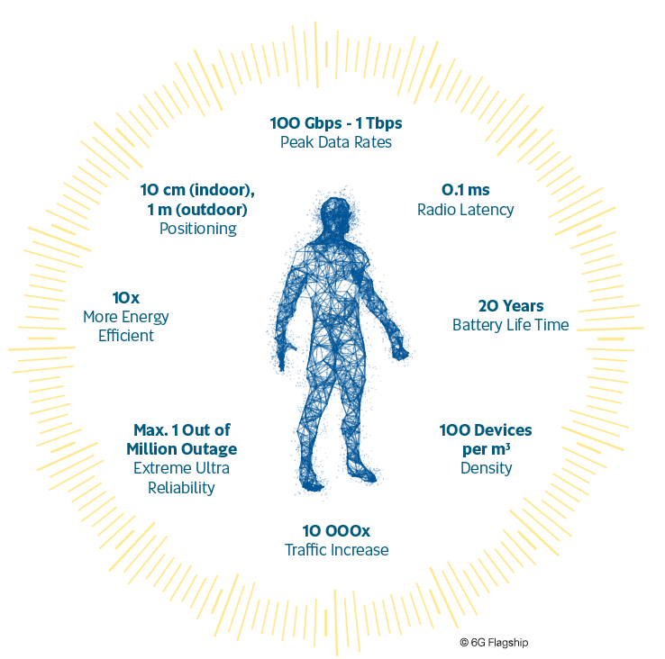
Wireless imperfectly applied – the 2.4GHz band
From KEY DRIVERS AND RESEARCH CHALLENGES FOR 6G UBIQUITOUS WIRELESS INTELLIGENCE, 6G SPECTRUM AND KPI TARGETS, we find targets of 100 devices/m³ density and 10,000x traffic increase.
In the IoT, many, if not most, will be short range devices (e.g. often within about 1-2m range)
Today, they are typified by BT (2.4 GHz ISM band) – 80 MHz bandwidth in 1MHz channels i.e., before consideration of interference which is common
It will be virtually impossible to accommodate the target, without new solutions and frequency bands
A 2.4GHz spectrum crisis is upon us. This band will continue to be widely used in 6G, including for BAN, but new solutions and frequency bands are essential (e.g. UWB, mmW, even wired).
Notes:
With regards to the spectrum challenge and getting back to the vision of Nicola Tesla that «“When wireless is perfectly applied the whole earth will be converted into a huge brain…”
Wireless today remains a work in-progress. It is yet still imperfectly applied (if not highly so). Moreover, as the number of devices incerases in the IoT to targets on the order of 100 devices / m3 and an increase in traffic of 10,000, we rapidly approach a spectrum crisis in the ever popular 2.4GHz band. Indeed, many, if not most, of our devices operate at short range in the 2.4GHz band.
The reason is that 2.4 GHZ radio is simple, readily available and low cost. Low cost will always be important, but we will also need to place greater emphasis on coexistance.
New solutions and frequency bands will be essential from RF to wired and 6G represents the occassion and opportunity for change, a change enabled by smart edge devices

Slide 18
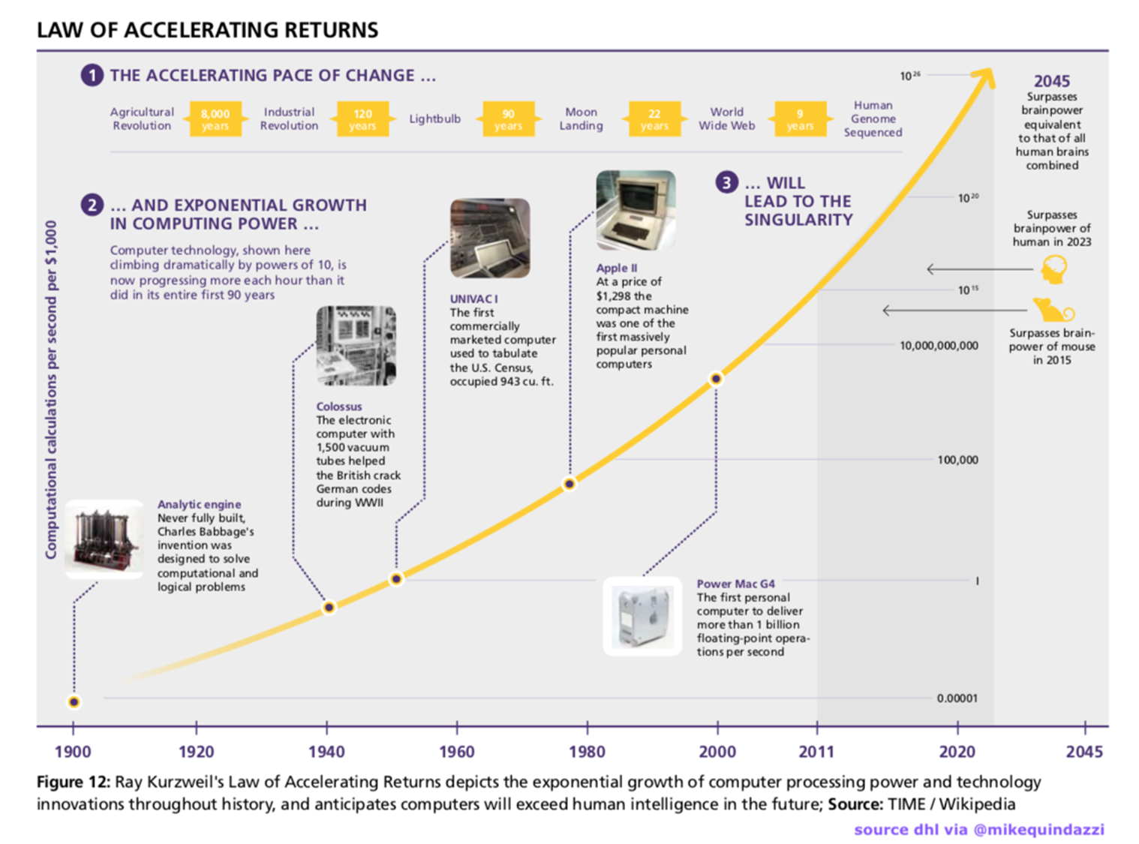
The law of accelerating returns…
At some point, the processing power available in even simple edge devices will be sufficient to support complex tasks.
Towards almost infinate processing power, on a chip, with virtuallly zero power consumption
AI enabled edge devices will be pervasive.
Our BAIoT edge devices can and will be part of a distributed intelligence enabled by 6G (e.g. distributed ID)
Enabling BAIoT for Health and more in a Digital Society
Notes:
Importantly for our vision of BAIoT in 6G, we can benefit from the law of accelerating returns where it concernms the capabilities of our smart edge devices.
From the curve, we can see that at some point in the not too distant future, the processing power available even in simple edge devices will be sufficient to support «complex» tasks.
We are headed towards the availability of almost infinate processing power power on a chip with virtually zero power consumption.
Smart edge devices will be pervasive and BAIoT edge devices, with 6G connectivity, will enable the realization of the kind of distributed intelligence (e.g. the cloud, distributed ID) envisioned by Tesla.
The prospects are at once exciting and yet also a bit frightenting, all the more reason why we need our own trusted interface in a complex Digital Society, from SmartBAN to smart BAIoT in 6G!

Slide 19


Thank you for your attention and see us at URSI GASS 2020!
Acknowledgments: The Hermes Partnership
Rome, Italy, https://www.ursi2020.org
KD1 Smart Body Area IoT (BAIoT) in the era of Beyond 5G/6G, conveners: J. Farserotu, H. Tanaka, D. Anzai
Abstract - The emergence of Smart Body Area IoT (BAIoT) including Wireless Body Area Networks (WBANs) including applica;ons in healthcare and medical monitoring, emergency response, search and rescue, military, etc. have triggered an extensive research effort to establish reliable communica;ons systems in the era of Beyond 5G/6G. However, the communica;on performance is expected to be strongly affected by the presence of a human body. To ensure stable communica;on in Smart BAIoT, we need to op;mize a communica;on system from various kinds of aspects: antenna structure, opera;ng frequency, modula;on and demodula;on, communica;on protocol including PHY/MAC, wireless network topology, security, privacy, trustworthiness and interoperability, for instance. The objec;ve of this session is to present state-of-the-art research related to Smart BAIoT systems and applica;ons in the era of Beyond 5G/6G. The session covers communica;ons as well as sensing in the Smart BAIoT domain. This topic is already of increasing importance, which also fits the focus areas of the URSI Commission K (Electromagnetics in Biology and Medicine).
Notes:
We would like to thank you for your attention
We would also like to take this occassion to acknowledge the support of the Hermes Partnership and to announce a workshop on the Smart body Area IoT in the era of Beyond 5G/6G at URSI GASS 2020 in Rome in September.

